Slide 1


Coil Gun
Zap

Slide 2
Working Principles
Design Architecture
Safety Principles
Plan of Action

Slide 3
Working Principles
Design Architecture
Safety Principles
Plan of Action

Slide 4


Electromagnets
Magnets that turn on and off via current running through wire
Magnetic field generated via RHR
Thumb in direction of current -> fingers coil in B-field
Coil of wire has magnetic field produced strongest internally

Slide 5
Magnetic Materials
Ferromagnetic
Paramagnetic
Diamagnetic
Attracted to both poles of a magnet, maintain magnetism after removal of external B-Fields
Attracted weakly to magnets, do not retain magnetism once B-field is removed
Repels magnets, does not retain magnetism once B-Field is removed

Slide 6

Coil Attraction
Ferromagnetic and Paramagnetic Materials attracted to the center of solenoids
Diamagnetic materials repelled from centre of coils
The stronger the B-Field produced, the stronger the force
However, in isolation the materials get stuck in the middle of the coil for attractive forces, or can’t enter the coil in the first place for repulsive forces

Slide 7

Coil Switching
This is why we use electromagnets instead of magnets
For attractive forces -> cut current after the projectile is past halfway point
For repulsive forces -> turn current on after projectile is past halfway point
Can be done with sensors or timers

Slide 8

How to generate a strong B-Field?
B-Field Proportional to current and a few other properties
Shorting a wire gives maximum current (internal wire resistance)
For a given length of wire, a voltage has a maximum current
Increase the voltage!
Batteries and power supplies throttle current for protection
Solution? Capacitors!

Slide 9
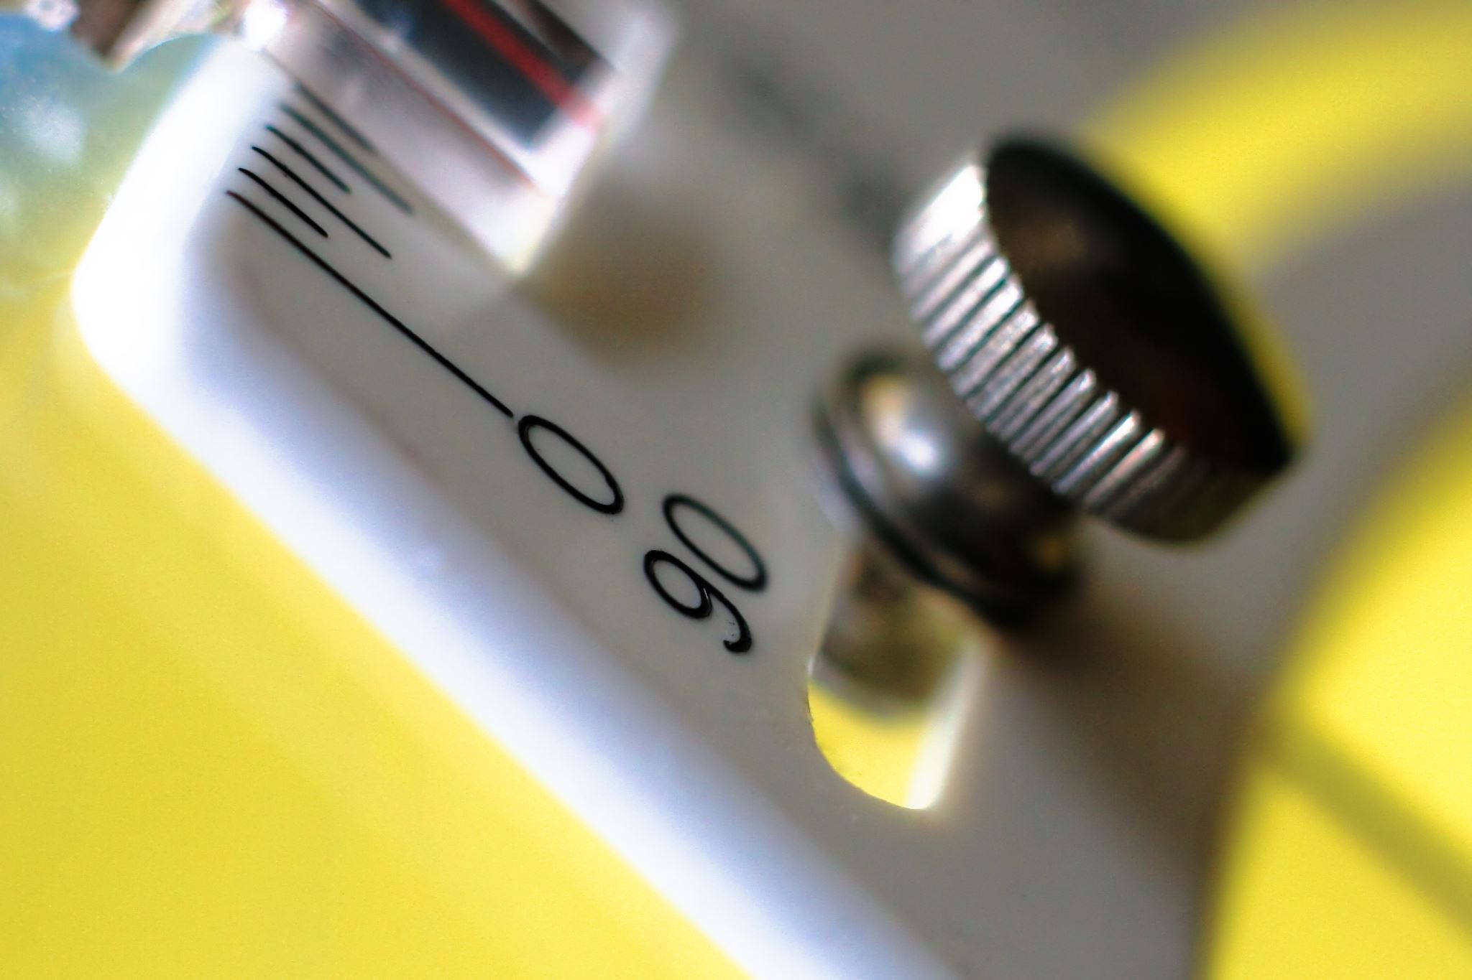
Capacitors
Charge caps to high voltage -> short caps through solenoid
Isn’t shorting Capacitors dangerous?
No! The coil is an inductor!

Slide 10
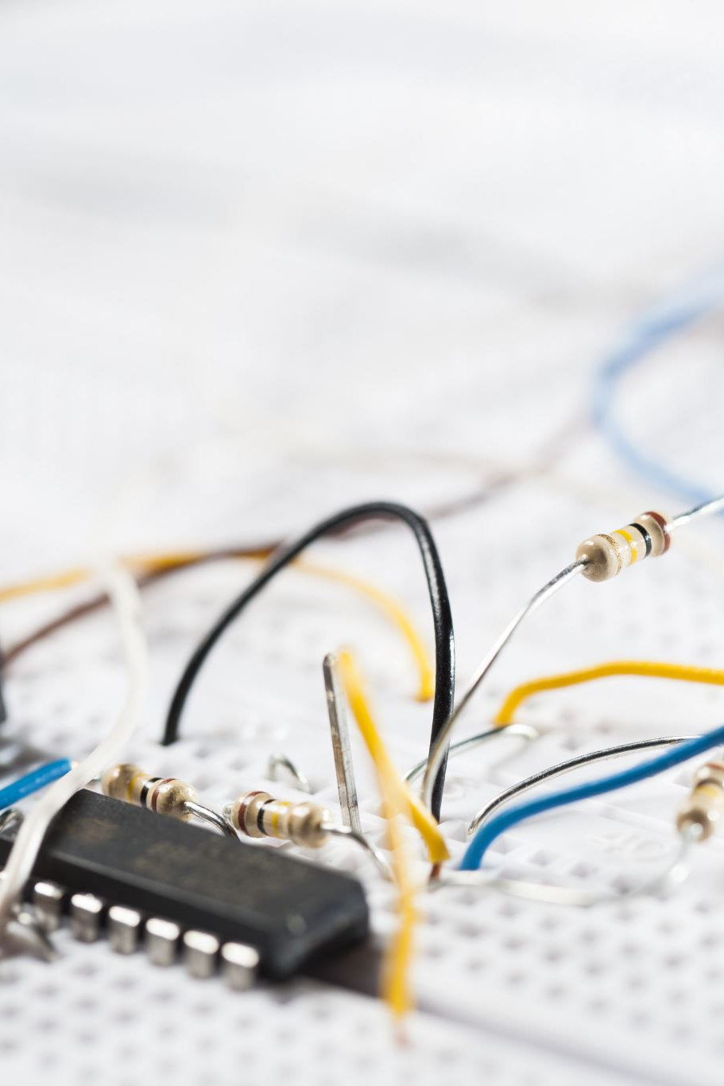
Recap
High voltage capacitors are charged
Shorting the capacitors through coils produces strong B-fields
B-Fields attract/repel magnetic materials to towards/away their center
Sensors or timers are used to stop current flow and allow projectile to accelerate

Slide 11
Working Principles
Design Architecture
Safety Principles
Plan of Action

Slide 12
Coil Gun Subsystems
Chassis
Propulsion
Controls
Safety

Slide 13

Chassis
Mechanical housing and mounting of all other subsystems
Ergonomic handling, projectile barrel, component housing, trigger, reload point
Coil and capacitor holder
Overall aesthetic design

Slide 14

Propulsion
Coil parameters: number of windings, wire gauges, coil thickness, coil length
Capacitor selection
Capacitor charging circuit

Slide 15

Controls
External sensors or timers for current cut
Voltage monitor
UI -> LEDs, LCD Screens,
Velocity monitor
Adjustable power level

Slide 16

Safety
Capacitor discharge circuit
Mechanical capacitor discharge mechanism
Bleeder Resistor
Deadman’s switch
Testing Rig, remote firing mechanism

Slide 17
Working Principles
Design Architecture
Safety Principles
Plan of Action

Slide 18
1. High voltage capacitors
Capacitors discharge almost instantaneously when shorted
Must stay under voltage rating
Polarity!
Reliable discharge methods, both mechanical and within system
Passive discharge
Video of capacitor short

Slide 19

2. Inductors
Instant current cutoff causes inductor kickback
Must include flyback diode

Slide 20

3. Component Ratings
All components in contact with HV wires need to be HV rated
Mechanical switches in series can fuse together at high voltages
Diode Breakdown voltages
uC ratings
HV can arc across small airgaps
Resistor W ratings

Slide 21
Safety Implementation
Design
Processes
Bleeder resistors
Capacitor discharge circuit
Testing Rig
Remote firing for testing
Dead man’s switch
Design to fail open
Electrical gloves
Safety Glasses
Test outside
Regular gun safety
Checklist
Indirect voltage measurement -terminals

Slide 22
Working Principles
Design Architecture
Safety Principles
Plan of Action

Slide 23
Design Division
Chassis – CAD Design, Trigger mechanism, Deadman's switch, component mounting.
Propulsion – Coil length, width, number of turns, and wire gauge. Capacitor selection.
Controls – PCB design, Modularity, Speed sensing, UI (LCD screen, LEDS, variable power)
Safety – Checklist, capacitor discharge circuit, mechanical discharge device, test rig,

Slide 24
Proposed Plan
Every meeting choose 1-3 things to complete for next meeting. If tasks are large/complex, further break down into individual tasks and choose
Record everything we do
Aim to have material ordered by Aug 2

Slide 25
Bill of Materials
Projectile + extras
Barrel material
PCB and electronic components
HV capacitors
COTS charging circuit?
Sensors (speed, detection)
Housing Material (3D Print? Injection Molding? Vaccuum Molding? Custom Part order?)
Buttons, LEDS, LCDs
Wire for coils
Microcontroller
Sensors

